Slide 1

Java : Features

Slide 2
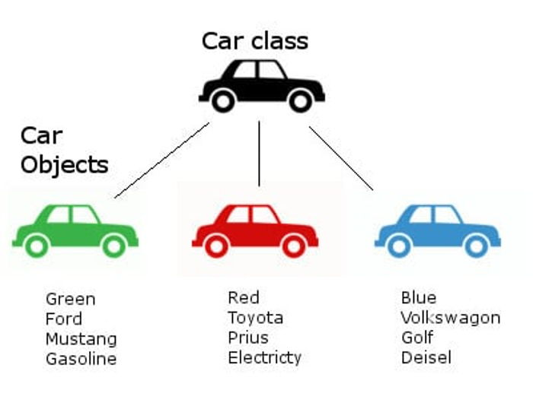
Object Oriented Programming (OOP)
Object oriented technique is modeled on the real world that we see all around.
A car represents a "class" meaning , it represent certain basic attributes and behavior.
Object Oriented Programming (OOP)

Slide 3
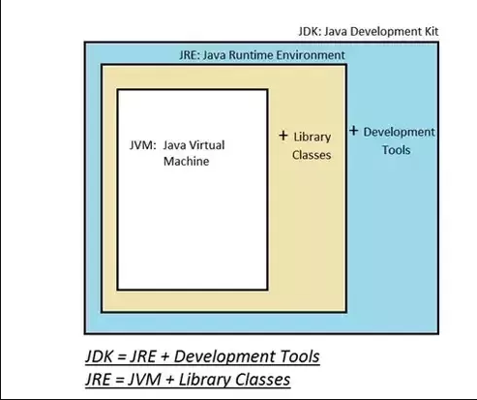
JVM vs JRE vs JDK
The Java virtual machine (JVM) is actually responsible for executing the compiled bytecode of a java program.
Java installation comes in two flavors, a Java Runtime Environment (JRE) & Java Development Kit (JDK).
The JRE is purely only for running the compiled java program and does not contains tools to compile a java program.
On the other hand JDK is a complete package with both compilation as well execution facility.

Slide 4
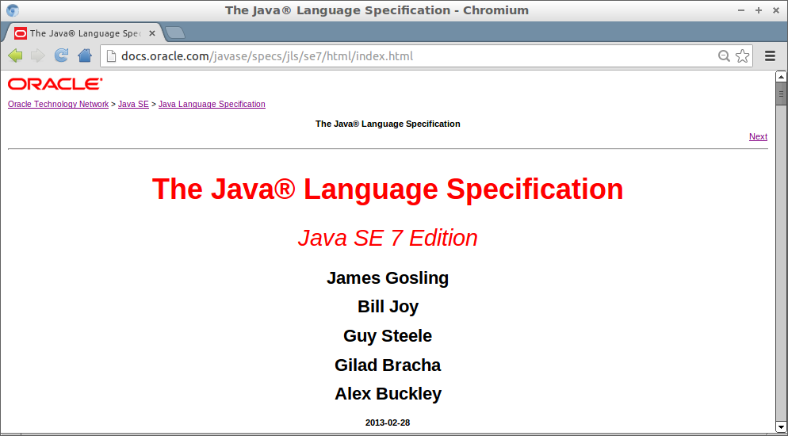
Java Specification
Java language specification is a document that defines essential parts of a java language implementation.
It defines all necessary grammar rules and syntax for java language.
Similarly there is a java virtual machine specification and JVM is a reference implementation for it also commonly referred to as Hotspot VM.

Slide 5
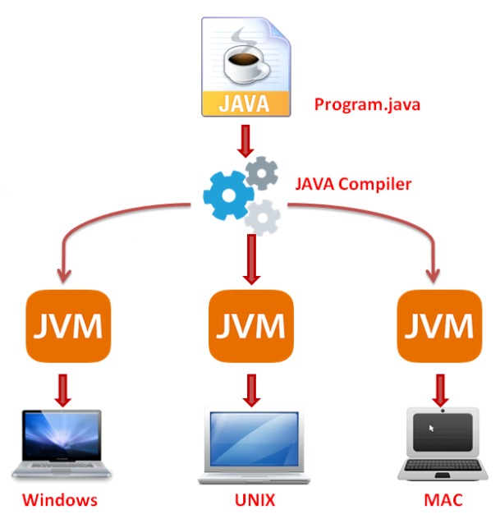
Write once, Run Anywhere
Java programing language is archtechturally neutral. This means that a java program once compiled can be taken and run on any system/processor which has the corresponding JVM installed.
This is referred to as write once and run anywhere feature of java.
This is made possible as a result of the bytecode that Java generates at the end of compilation process.
Java also provides JVM implementations for major OS/processor types like windows,unix,mac etc.
The bytecode then gets executed on platform specific JVM.

Slide 6

Memory Management
Java provides in build memory management facility.
Java’s memory manager is referred to as garbage collector.
A java programmer does not need to take care of creating and destroying memory.
Earlier in languages like C , it was required to first reserve memory and after usage it had to destroyed.
In java , a programmer can just signal the garbage collector to run but it is the sole responsibility of java runtime system to run garbage collector.

Slide 7

Questions ??

